Slide 1

SUPERSTORE
End-to-End Sales & Profitability Analysis
Python · SQL · Power BI
Crafted by Tanushree Mazumdar – Portfolio Driven

Slide 2



Why Analyze Superstore Sales & Profitability?
Dataset Scope:
9,994 transactions spanning 4 years | 2014 – 2017
Core Categories:
Furniture . Office Supplies . Technology
Strategic Objective:
Identify sales trends, profit drivers, & optimization opportunities

Slide 3

Python - Data Cleaning & Preparation
Handling Duplicates & Aggregation
Found 16 duplicate rows based on ‘Order ID’ & ‘Product ID’.
Aggregate duplicate entries to ensure data accuracy.
Import Data
Load Orders, Returns, & People datasets
Convert Dates
Transform ‘Order Date’ & ‘Ship Date’ to determine format
Sales - summed
Quantity - summed
Missing Values
Verify data integrity, no missing values found
Profit - summed
Discount – first value

Slide 4
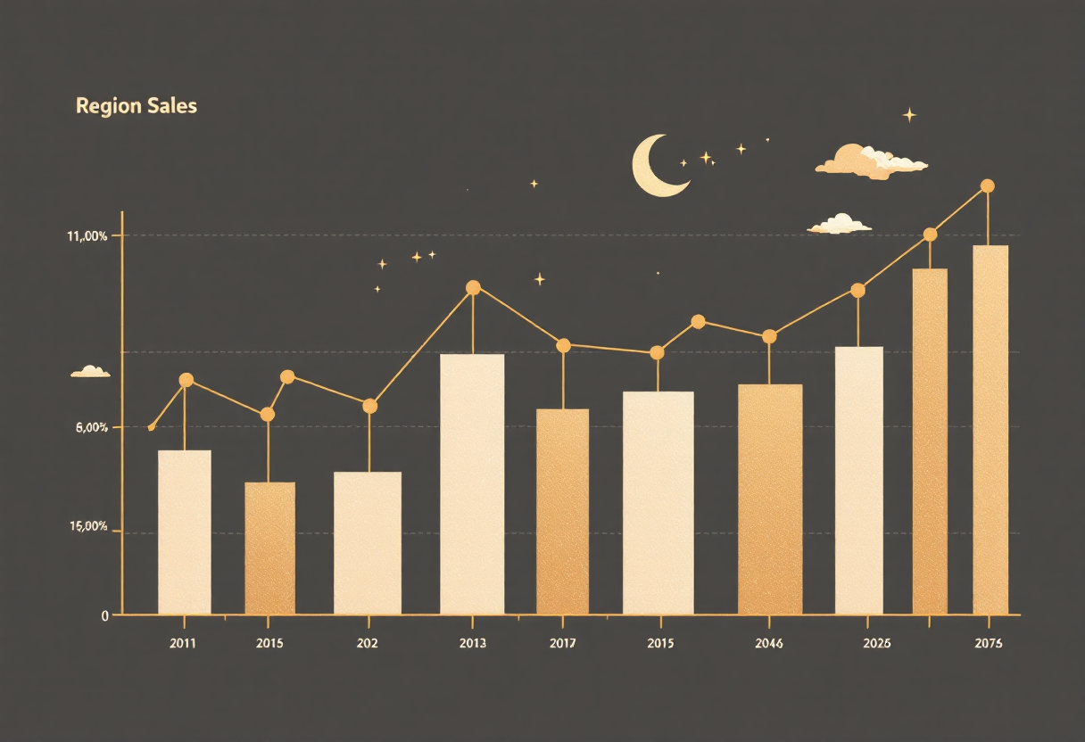
Python - Exploratory Data Analysis (EDA)
Key insights from aggregated data
725K
West Region Sales
Highest total sales
108K
West Region Profit
Leading in profitability
25K
Top Product Profit
Canon imageCLASS 2200 Advanced Copier

Slide 5
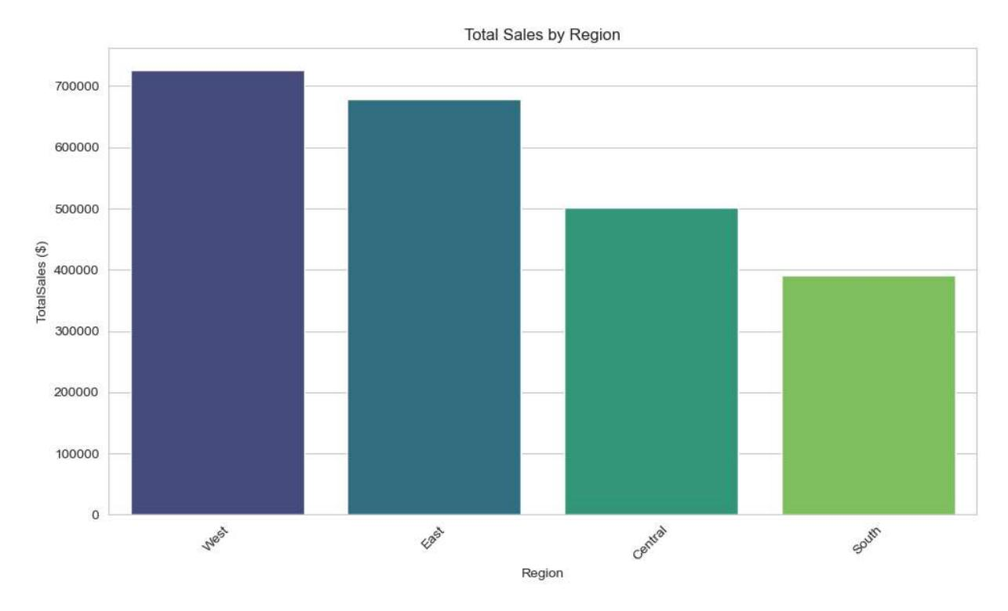
Python – Regional Sales Performance
West & East regions dominate in total sales.
West | 725458 | 108418
East | 678781 | 91522.8
Central | 501240 | 39706.4
South | 391722 | 46749.4

Slide 6
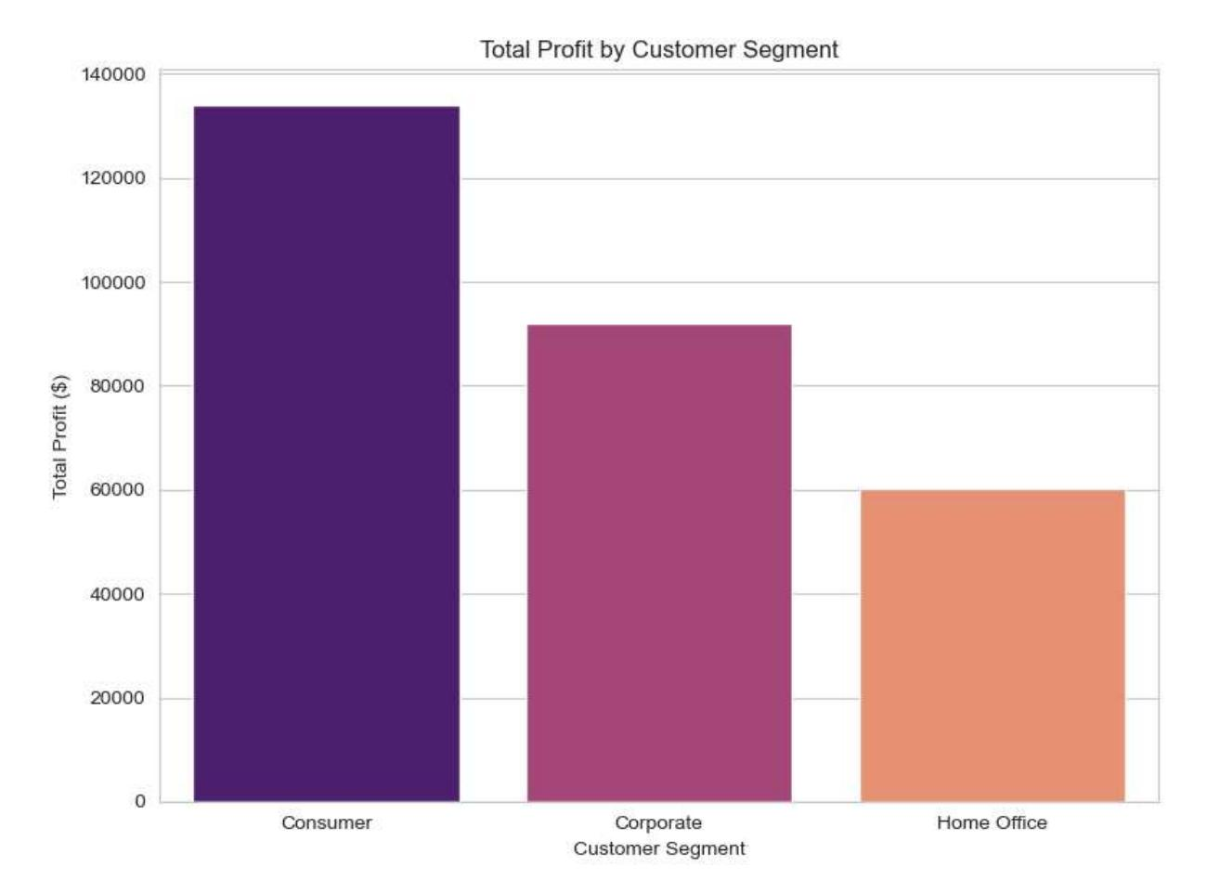
Python – Profit by Customer Segment
Consumers drive the highest sales, but Corporate & Home Office segments also contribute significantly to profit
Consumer
Sales: $1.16M, Profit: $13.4K
Corporate Customer Segment
Sales: $0.70M, Profit: $91K
Home Office
Sales: $0.43M, Profit: $60K

Slide 7
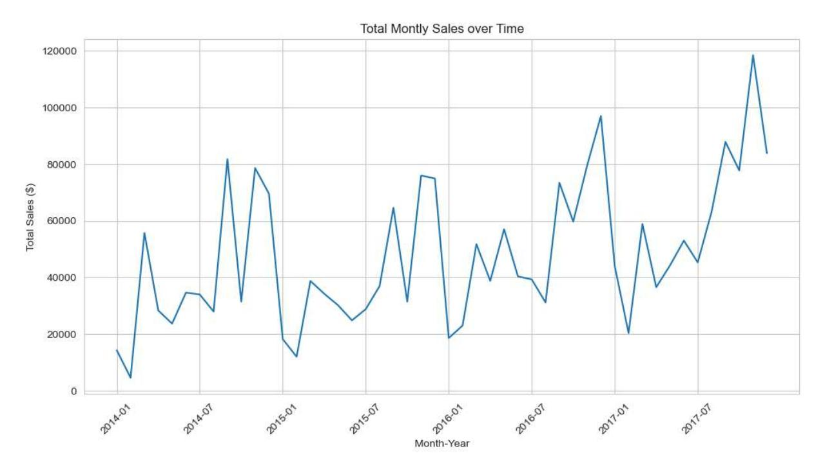
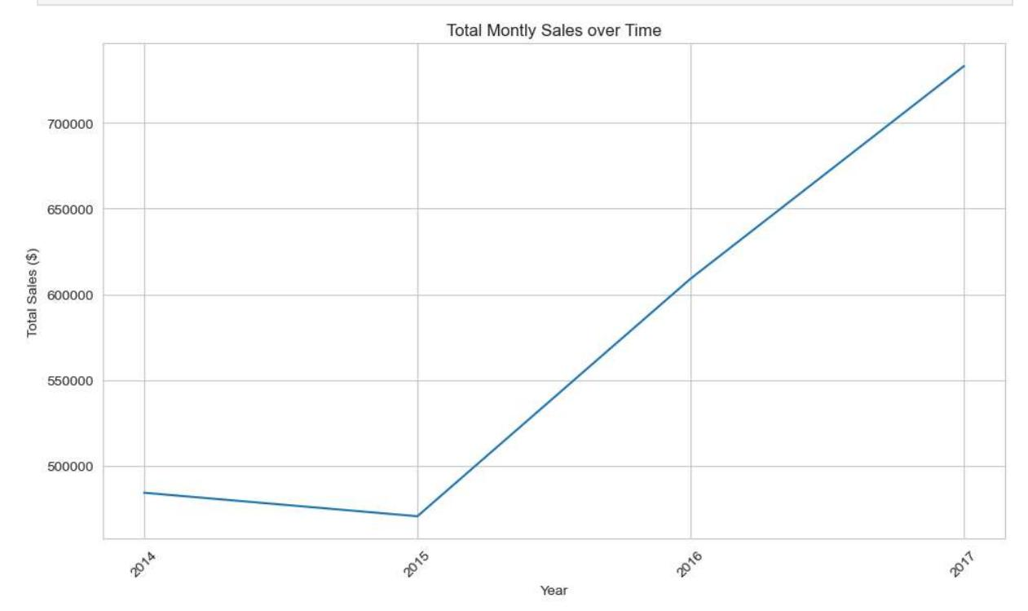
Python - Sales Over Trend
Monthly Sales
Yearly Sales
Fluctuations observed, with peaks & troughs throughout the years
Overall upward trend, indicating growth over time

Slide 8


Python- Machine learning: Profit Prediction
Linear Regression
Predicting profit amount
MAE: 71.44
MSE: 75835.26
R2: 0.02
Logistic Regression
Classifying High/Low Profit
Accuracy: 0.697
Precision: 0.72 (Low), 0.67 (High)

Slide 9








Export to SQL Database
Final processed data exported for future use
Orders Table
Aggregated order details
Returns Table
296 unique returned orders
People Table
4 unique regional managers

Slide 10





SQL – Transactional Risk Analysis
Deep Dive 1: Identifying Loss – Making Orders to minimize financial risk
Order ID | Order Date | Customer Name | Region | Total Sales | Total Profit/Loss | Avg. Discount (%)
CA-2014-169019 | 26-07-2014 | Luke Foster | Central | 2656.72 | -3791.16 | 66.67
US-2017-122714 | 07-12-2017 | Henry Goldwyn | Central | 1889.99 | -2929.48 | 80.00
CA-2017-131254 | 19-11-2017 | Nathan Cano | Central | 1716.25 | -2334.18 | 55.00
CA-2014-139892 | 08-09-2014 | Becky Martin | Central | 10353.92 | -1897.33 | 42.50
CA-2016-130946 | 08-04-2016 | Zuschuss Carroll | Central | 1184.77 | -1855.06 | 55.00
CA-2014-165309 | 11-11-2014 | Karen Daniels | Central | 898.22 | -1482 | 80.00
CA-2015-140025 | 07-04-2015 | Peter Fuller | Central | 463.25 | -1181.28 | 80.00
CA-2017-152093 | 10-09-2017 | Skye Norling | Central | 762.59 | -1143.89 | 80.00
US-2017-148551 | 12-01-2017 | David Bremer | Central | 760.98 | -1141.47 | 80.00
CA-2016-103982 | 03-03-2016 | Alex Avila | Central | 3930.07 | -786.01 | 20.00
High Discount Impact
Discounts of 80-60% drive most losses
Regional Risk
Central regions shows higher unprofitable orders
Critical Threshold
Orders above 40% discount need monitoring
Loss Range
Average loss: $786.01-$3791.16 per order

Slide 11




SQL – Time Series & Trend Analysis
Year-over-Year Sales Growth Analysis (2014-2017)
Order Year | Total Annual Sales | Previous Yearly Sales | YoY Growth%
2014 | 484247.56 | NULL | NULL
2015 | 470532.46 | 484247.56 | -2.83
2016 | 609205.86 | 470532.46 | 29.47
2017 | 733215.19 | 609205.86 | 20.35
Resilient Growth
Strong recovery achieved after a brief -2.83% dip in 2015
Peak Performance
2016 achieved highest growth at 29.47%
Growth Trend
Average annual growth of 15.33% across period
Steady Expansion
Growth demonstrated resilience and a sustainable recovery pattern

Slide 12




SQL – Product Profitability Ranking
Category | Sub_Category | Total Profit | Profit Rank
Technology | Copiers | 55617.9 | 1
Technology | Phones | 44516.25 | 2
Technology | Accessories | 41936.78 | 3
Office Supplies | Paper | 34053.34 | 4
Office Supplies | Binders | 30221.64 | 5
Furniture | Chairs | 26590.15 | 6
Office Supplies | Storage | 21279.05 | 7
Office Supplies | Appliances | 18138.07 | 8
Furniture | Furnishings | 13059.25 | 9
Office Supplies | Envelopes | 6964.1 | 10
Office Supplies | Art | 6527.96 | 11
Office Supplies | Labels | 5546.18 | 12
Technology | Machines | 3384.73 | 13
Office Supplies | Fasteners | 949.53 | 14
Office Supplies | Supplies | -1188.99 | 15
Furniture | Bookcases | -3472.56 | 16
Furniture | Tables | -17725.6 | 17
Category & Sub-Category Performance Analysis
Top Performers
Copiers & Phones lead profitability
Attention Needed
Lower-ranked items need strategy view
Technology Dominance
Tech sub-categories rank highest overall
Category Mix
Technology dominates the top of the ranking, driving majority profit

Slide 13

Data Analysis & Visualization Pipeline
SQL- Data Extraction & Transformation
Transformed raw source files into a unified, verified dataset in the SQL layer, accelerating reporting and analytical accuracy.
Power BI – Interactive Dashboards & Reporting
Power BI delivers interactive dashboards to track key performance indicators (KPIs) and drive data-backed decisions.

Slide 14

Power BI – Customer & Return Analysis
Loyal Customers
Customers like Claire Gute, Brosina Hoffman, Irene Maddox, and more 4196 unique customers have never returned a product, indicating high satisfaction.
Affected Region
Analyzing return from Regions highlights areas needing attention in product quality or customer service mostly
East 103
West 86,
South 79,
Central 15
East region has the highest number of returns, suggesting potential issues that need further investigation

Slide 15

Product Categories Affected by Returns
Region Returns
East
Office Supplies - 103
West
Office Supplies – 52
Technology - 34
South
Furniture – 20
Office Supplies – 4
Technology - 55
Central
Office Supplies - 15

Slide 16
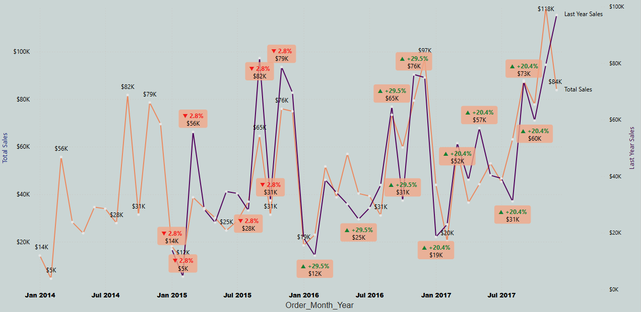
Power BI – Monthly Sales & Profit Trends
Sales & Profit shows significant fluctuations, with notable peaks towards the end of the year, suggesting seasonal buying patterns.

Slide 17





Power BI – Key Sales Personnel
Name: Anna Andreadi
Region: West
Total Sales: $7,23,854.69
Highest Growth Margin State:
Washington 24.09%
Utah 22.70%
Name: Cassandra Brandow
Region: South
Total Sales: $3,83,240.20
Highest Growth Margin State:
Arkansas 34.33%
Georgia 33.10%
Name: Kelly Williams
Region: Central
Total Sales: $4,96,060.11
Highest Growth Margin State:
Minnesota 36.24%
Indiana 34.33%
Name: Chuck Magee
Region: East
Total Sales: $6,66143.34
Highest Growth Margin State:
Delaware 36.35%
Rhode Island 32.20%

Slide 18





Conclusion & Strategic Recommendations
Optimize Focus
Prioritise high-margin categories & regions for sustained growth
Next Steps
Implement the dashboards for continuous monitoring & adaptive decision-making
Enhance Shipping
Invest in faster shipping to boost customer satisfaction & drive sales
Refine Discounts
Strategically adjust discount policies to balances sales volume with profitability
Leverage Insights
Utilise customer & salesperson data to target campaigns effectively

